Slide 1
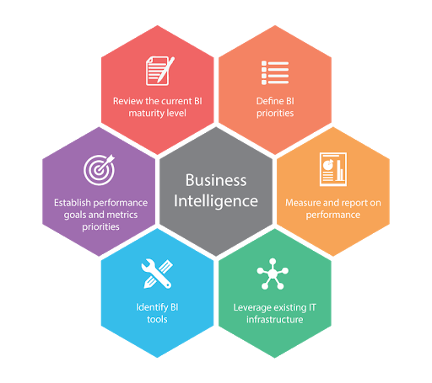
VARUN TYAGI
Contact Details:
Phone: +91-7503840470
Skype: iamvarun789
Gmail: varuntyagi3112@gmail.com

Slide 2
Background:
B.Tech in Computer Science & Engineering
3+ years of experience in facilitating data analytical engagements with multiple F-500 BFSI clients for US based MNC
Experience analyzing and interpreting high volumes of complex data
Performed descriptive analysis on data and created insightful dashboards
I work on Excel VBA, Python, Tableau, SQL, DWH, Power BI, Google Data Studio helping team and leaders to deliver the best.
My work involves problem understanding, problem identification, planning, development and project management.
I believe there is always a better way to innovate and collaborate. I look deeper, I find it, and I make it happen.

Slide 3
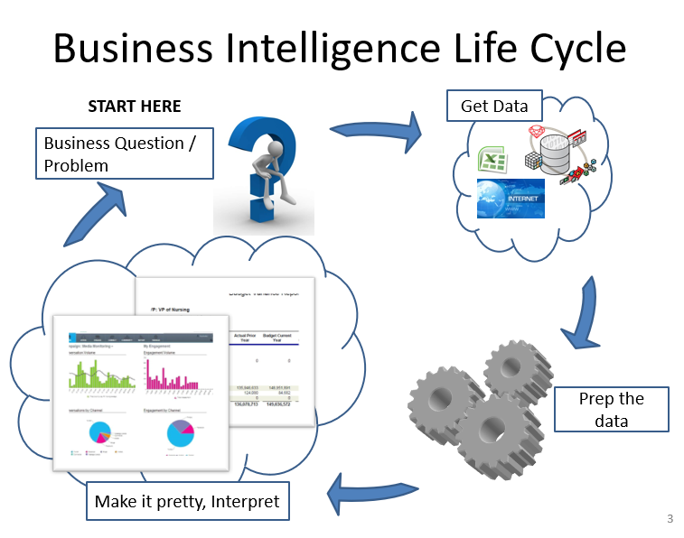
Work Process:

Slide 4
WHY IT WORKS FOR YOU:
My work will give you a winning effective solution that can surely convert your efforts into greater success and growth, proven by qualitative and quantitative metrics and data driven approach.
My business decision making will transform your faith into trust.

Slide 5
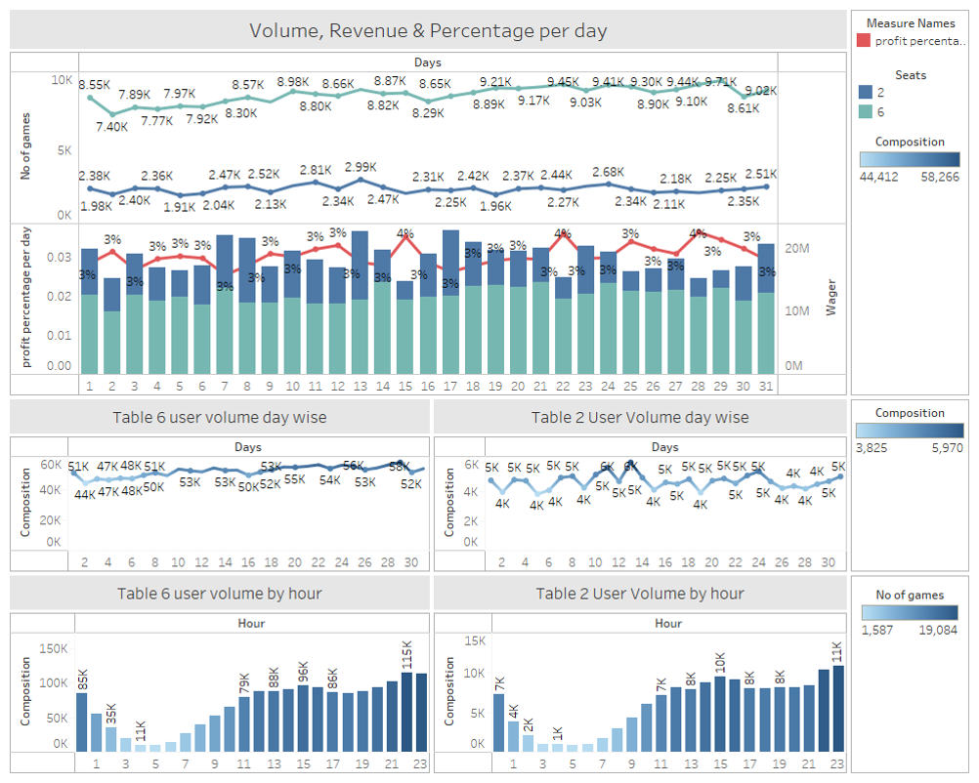
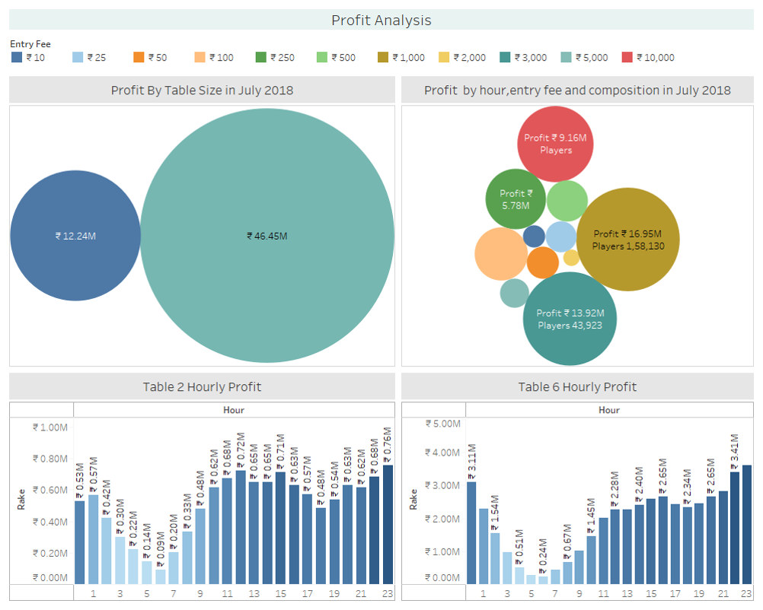
Previous Works Demo #1-Tableau, SQL, MS-Access, Excel VBA:
Game and User Flow Analysis:

Slide 6
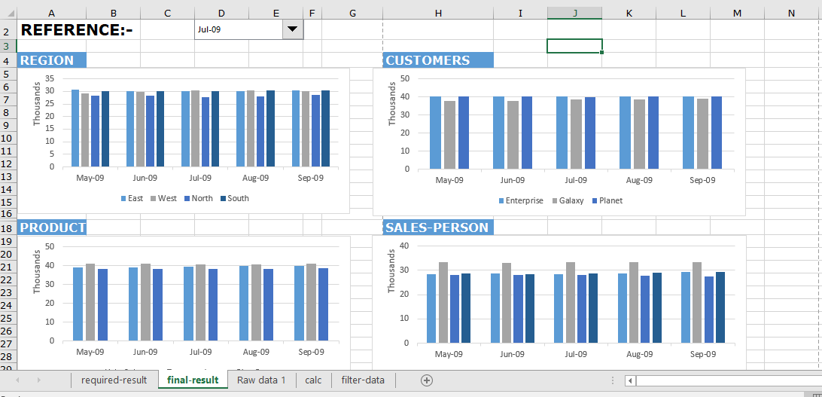
Previous Works Demo #2 – Excel, SQL, Power Query:
Sales Performance Dashboard:

Slide 7
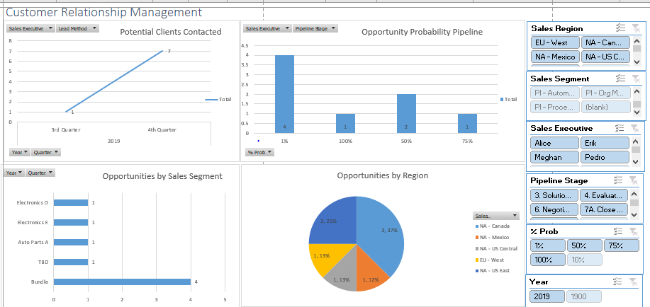
Previous Works Demo #3- Excel, VBA,SAP Crystal:
Customer Relationship Management Dashboard:

Slide 8
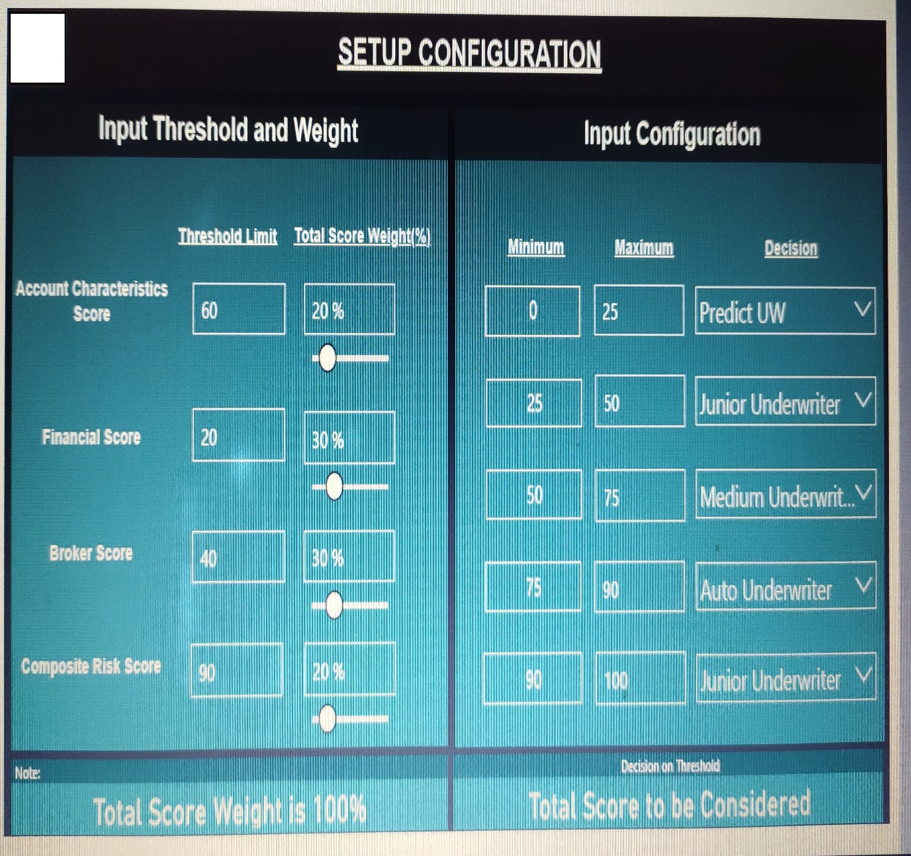
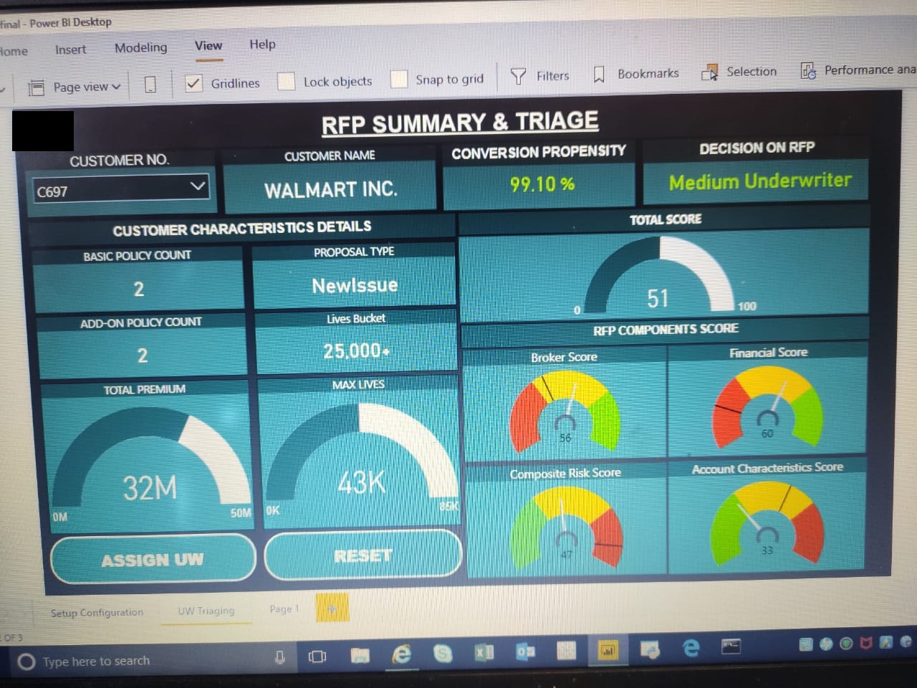
Previous Works Demo #4- Power BI, SQL , Python, ML:
Request For Proposal and Underwriter Triaging Analysis:

Slide 9
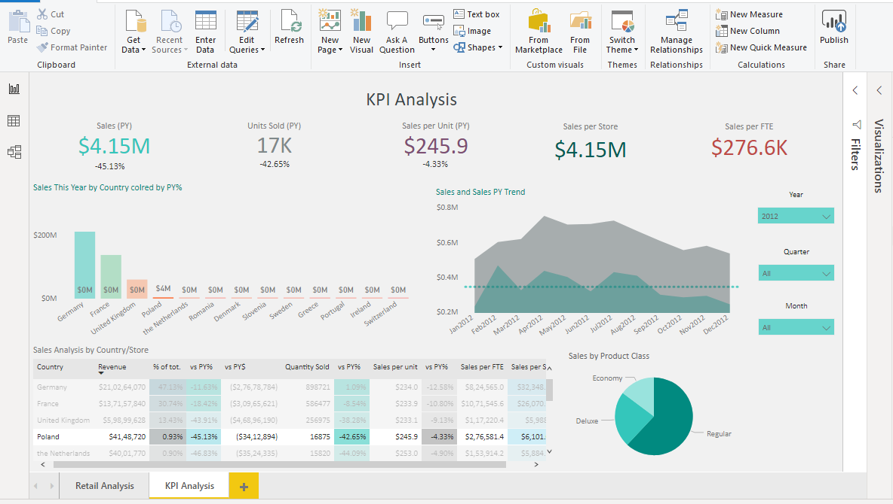
Previous Works Demo #5- R, Power BI, SQL, Excel, MS-Access:
Customer Relationship Management Dashboard:

Slide 10
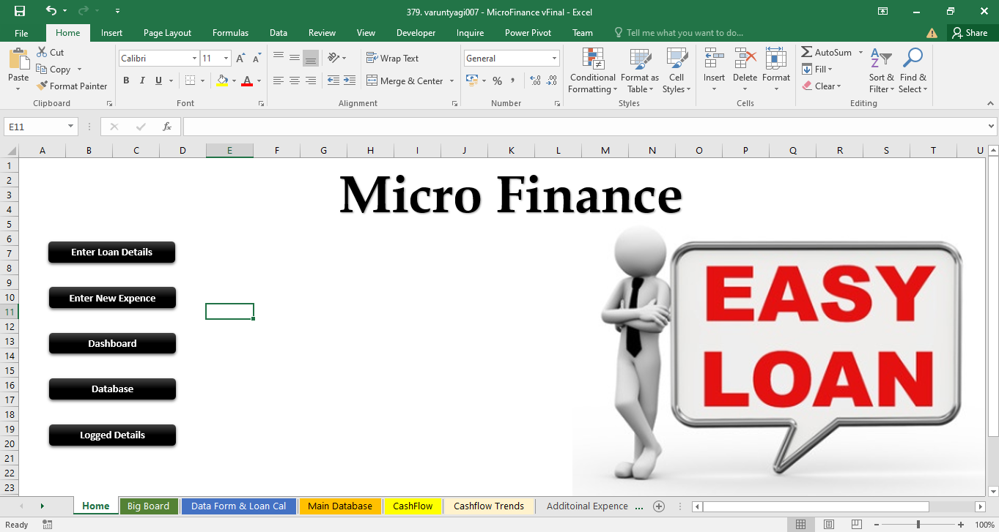
Previous Works Demo #6- Excel, VBA, PowerPivots, Finance Knowledge:
Microfinance Tool and Cash Flow Analysis Dashboard:

Slide 11
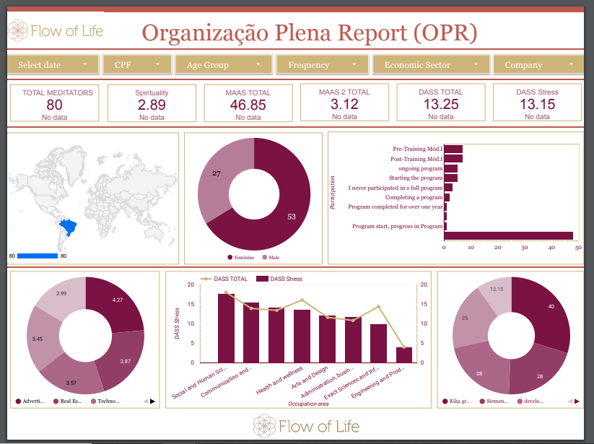
Previous Works Demo #7- Excel, Google Sheets, Google Data Studio, Meditation Survey Data:
Meditation Self-Assessment Flow Analysis Dashboard:

Slide 12
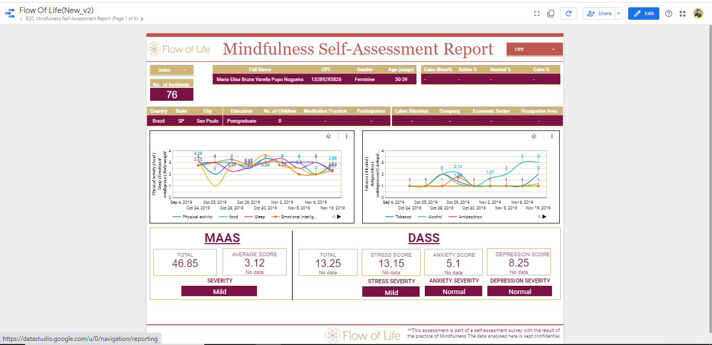
….continued:
Meditation Self-Assessment Flow Analysis Dashboard:

Slide 13
WHAT CLIENTS SAY:
"We were amazed not only by his creativity and professionalism, but by seeing a huge increase in our conversion rates."
"He created a cohesiveness to my problems that has increased credibility and name recognition for my business“
"He worked with us in the collection, integration, analysis, and presentation of business information. and it has made a huge impact within its target audience."

Slide 14
Ready to Hire?

